Slide 1
Gases
March 22, 2012

Slide 2
Announcements
Test Part 1 – Friday, March 30th – M.C./Fill in Blank
Test Part 2 – Monday, April 2nd – Problems
Missing Homework – Check Parent Connect. All homework must be in on Monday.
Questions?

Slide 3
Quiz
You must show all your units for this quiz. If you don’t have units, you will automatically lose half of the points.
Derive the gas constant using units of atm for pressure.
If I have 2.9 L of gas at a pressure of 5.0 atm and a temperature of 50°C, what will be the temperature of the gas if I decrease the volume of the gas to 2.4 L and decrease the pressure to 3.0 atm?
How many moles of oxygen must be placed in a 2.00 L container in order to exert a pressure of 202.6 kPa at 25°C?

Slide 4
NCAA Tournament
Michigan State plays Louisville tonight at 7:47 p.m.!
Go Green!

Slide 5
Today’s Objective
SWBAT: Analyze and solve problems involving diffusion and effusion.

Slide 6
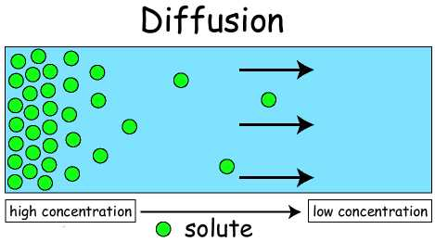
Diffusion
Diffusion: The movement of particles from areas of higher density to areas of lower density.

Slide 7
Diffusion
Would particles of higher or lower mass diffuse faster?
Diffusion causes an increase in entropy.
Entropy is a measure of disorder.
An increase in disorder causes an increase in entropy.

Slide 8
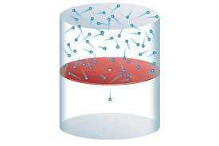
Effusion
Effusion: The passage of a gas under pressure through a tiny opening.

Slide 9
Effusion
Studied by Thomas Graham.
At constant T and P, the rate of effusion of a gas is inversely proportional to the square root of the gas’s molar mass.
Graham’s Law of Diffusion

Slide 10
Example
Oxygen molecules have an average speed of about 480 m/s at room temperature. At the same temperature, what is the average speed of molecules of Sulfur Hexafluoride, SF₆?

Slide 11
Gay-Lussac’s Law of Combining Volumes
If pressure and temperature are kept constant, gases react in volume proportions that are whole numbers.

Slide 12
Homework
Read pg. 436-440. Add to your notes as needed.
Pg.438 #’s 1-4

